Slide 1
Cannabis (Marijuana) is illegal for anyone under the age of 21 in NYS. It is also harmful. The teen brain is actively developing and continues to develop until around age 25. Marijuana use during adolescence and young adulthood may harm the developing brain.

Slide 2
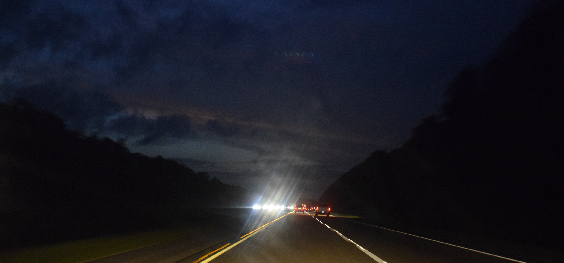
Marijuana significantly impairs judgment,
motor coordination, and reaction time. Studies have found a direct relationship between blood THC concentration and impaired driving ability.
(NIDA)
FOCUS ON PREVENTION
Notes:
Source: Does marijuana use affect driving? | National Institute on Drug Abuse (NIDA) (nih.gov)

Slide 3
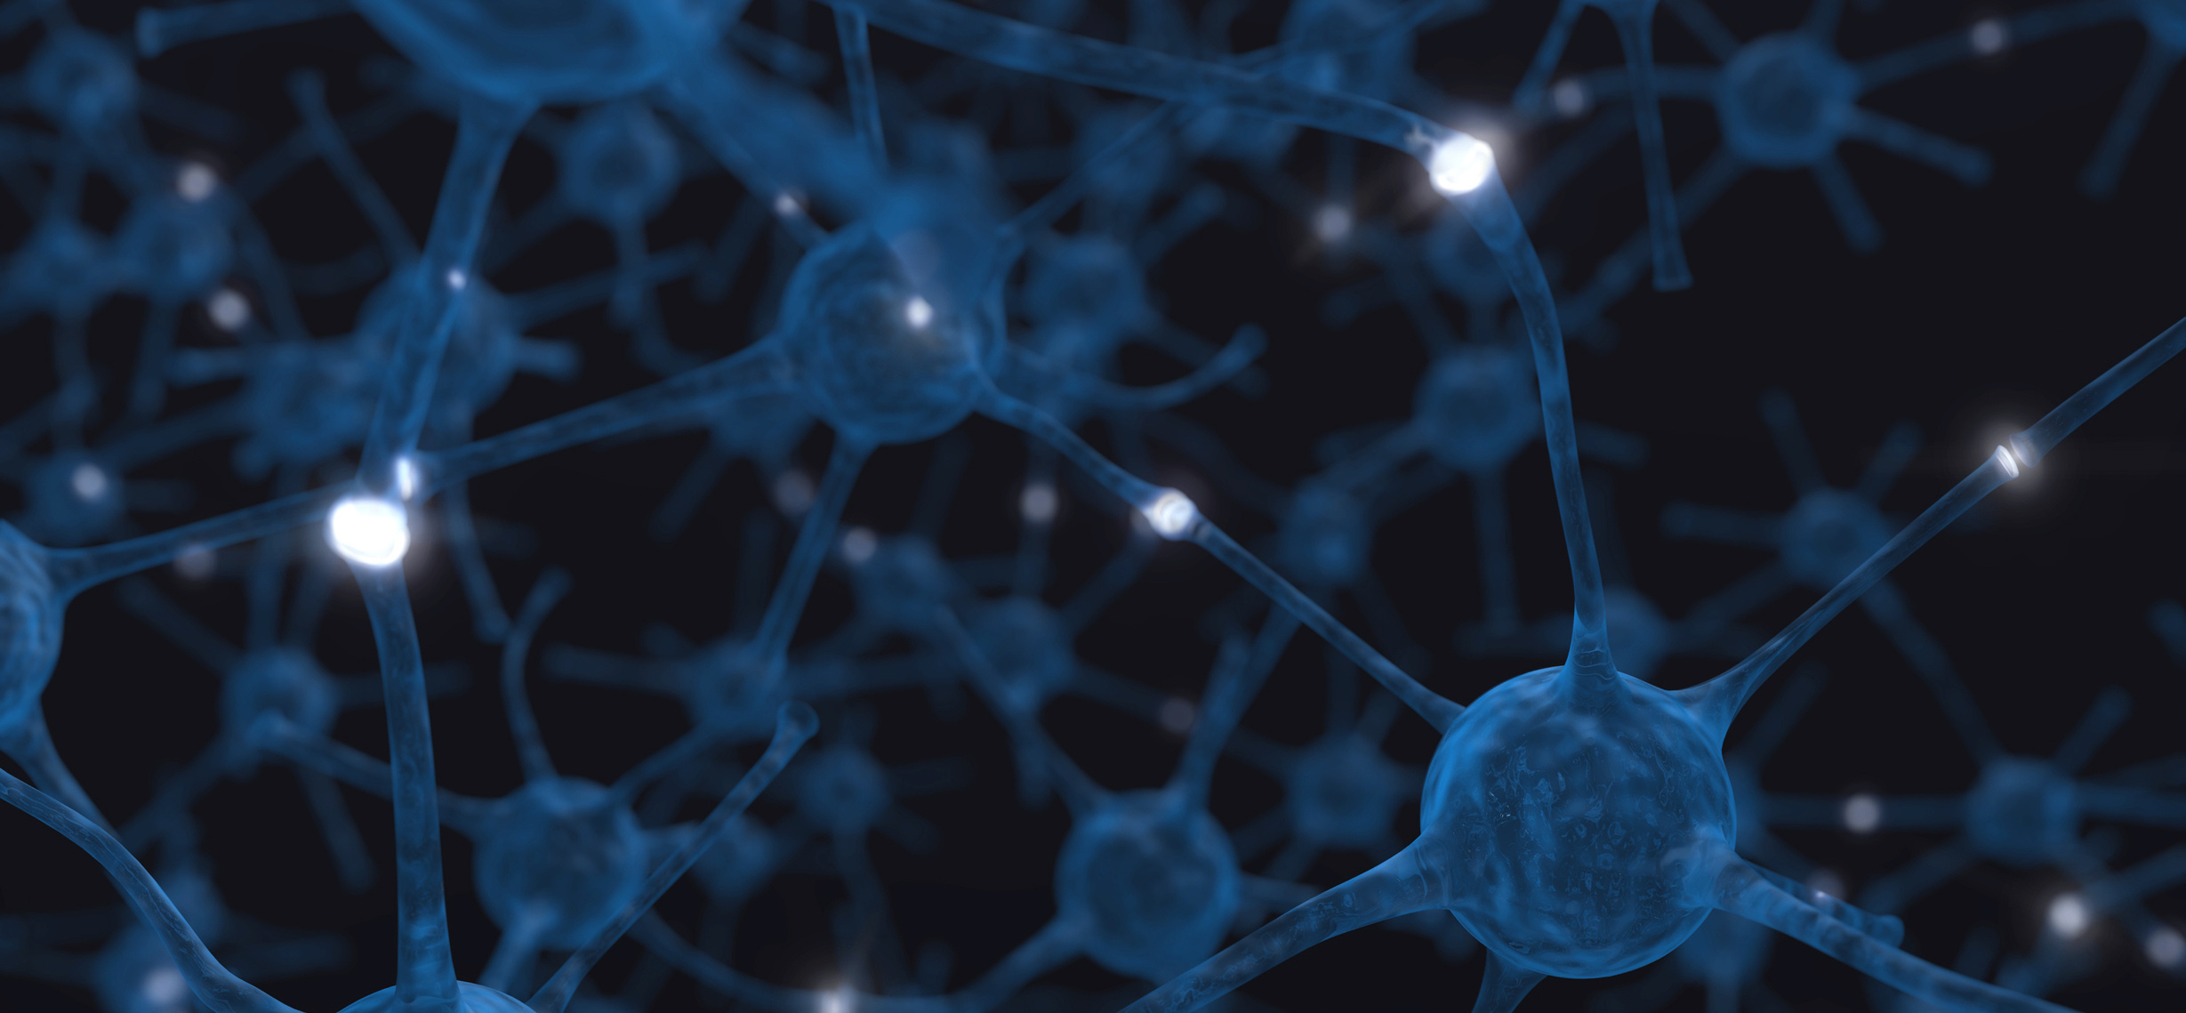
People who use excessive doses of THC may experience acute psychosis; including hallucinations, delusions, and a loss of the sense of personal identity.
(NIH)
FOCUS ON PREVENTION
Notes:
Source: How does marijuana produce its effects? | National Institute on Drug Abuse (NIDA) (nih.gov)

Slide 4
Given the potential of marijuana to negatively impact the developing brain, the American College of Obstetricians and Gynecologists recommends that obstetricians-gynecologists counsel women against using marijuana while trying to get pregnant, during pregnancy, and while they are breastfeeding.
(ACOG)
FOCUS ON PREVENTION
Notes:
Source: Marijuana and Pregnancy | ACOG

Slide 5
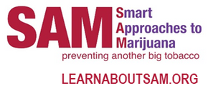
BIG MARIJUANA
IS BORROWING FROM
BIG TOBACCO'S PLAYBOOK
IN SEARCH OF THE SAME DEEP PROFITS.
The marijuana industry targets younger, more frequent users because they're the most likely to get hooked – thus are potentially the most profitable. And the pot industry funds lobbyists and special interest groups to downplay the health risks, much like Big Tobacco did with cigarettes decades ago.
FOCUS ON PREVENTION
Notes:
Source: Big Tobacco 2.0: Big Marijuana – Smart Approaches to Marijuana (learnaboutsam.org)

Slide 6
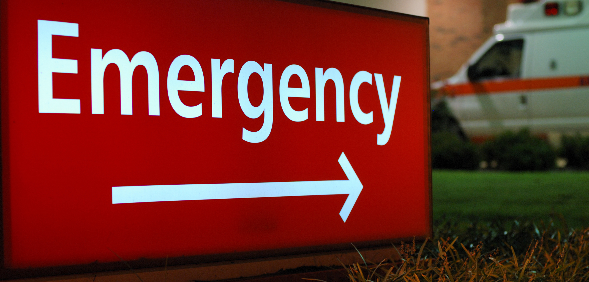
Increases in potency may account for the rise in emergency room visits
involving marijuana use.
(NIDA)
FOCUS ON PREVENTION
Notes:
Source: Cannabis (Marijuana) DrugFacts | National Institute on Drug Abuse (NIDA) (nih.gov)

Slide 7
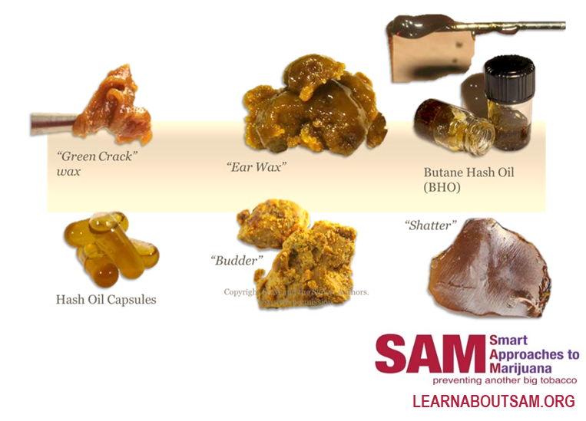
NOT "JUST A PLANT" ANYMORE...
Marijuana concentrates are often referred to as 710 (the word "OIL" flipped and spelled backwards), wax, ear wax, honey oil, “budder,” butane hash oil, butane honey oil (BHO), shatter, dabs (dabbing), black glass, and errl.
FOCUS ON PREVENTION
Notes:
Source: What You Should Know About Marijuana Concentrates/ Honey Butane Oil | Get Smart About Drugs (dea.gov)

Slide 8
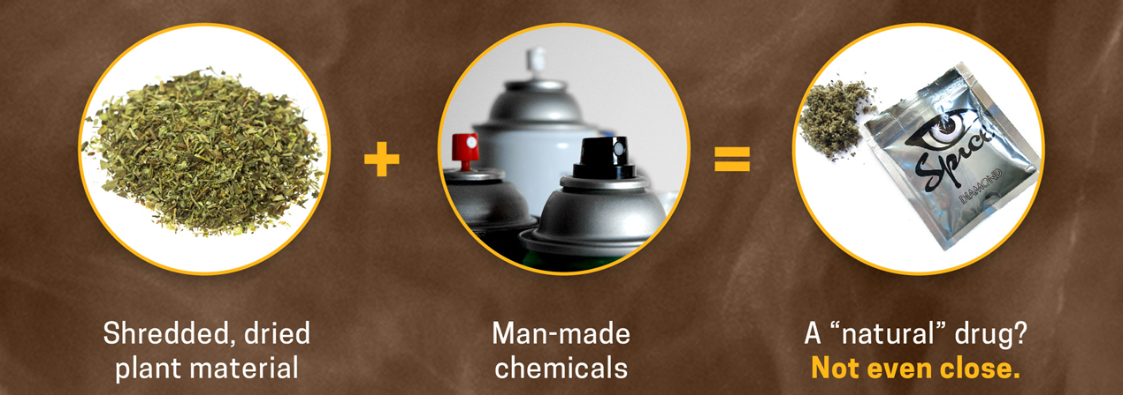
k2/spice is NOT marijuana
The effects of K2/SPICE can be unpredictable and in some cases, severe or even life-threatening.
(NIH)
FOCUS ON PREVENTION
Notes:
Source: Synthetic Cannabinoids (K2/Spice) DrugFacts | National Institute on Drug Abuse (NIDA) (nih.gov)

Slide 9
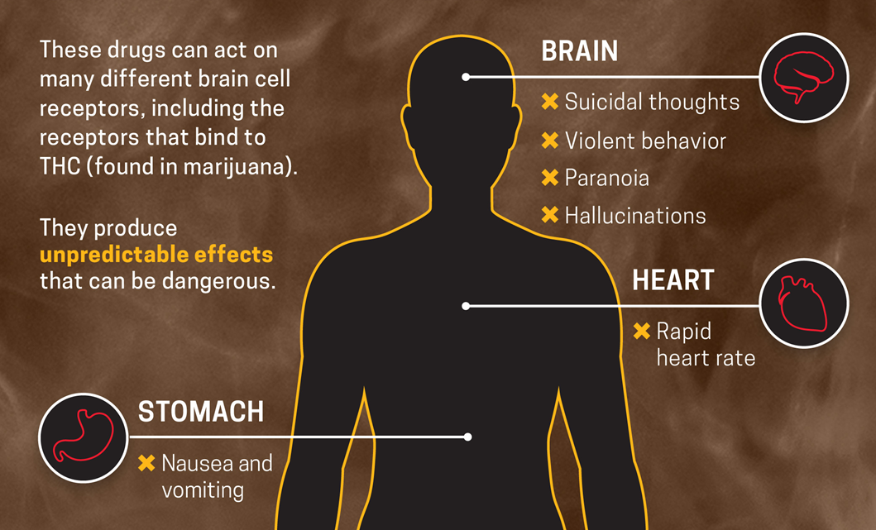
synthetic cannabinoids (k2/spice)
unpredictable danger
(NIH)
FOCUS ON PREVENTION
Notes:
Source: Synthetic Cannabinoids (K2/Spice) DrugFacts | National Institute on Drug Abuse (NIDA) (nih.gov)

Slide 10
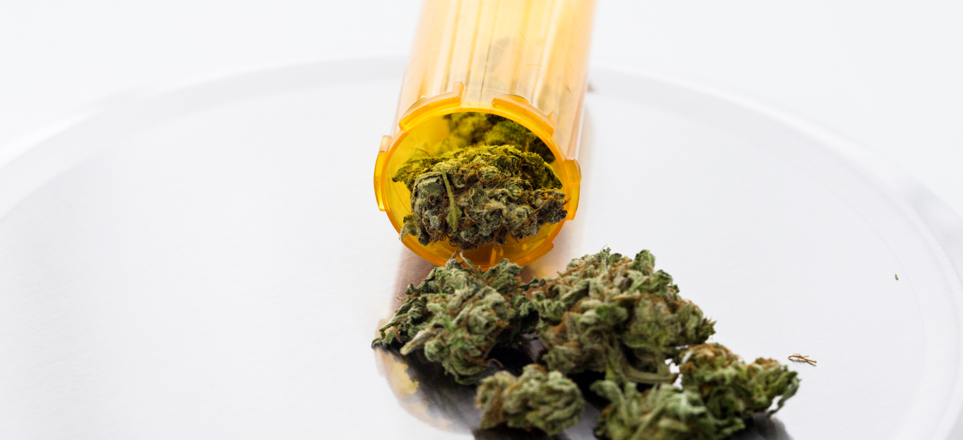
The U.S. Food and Drug Administration (FDA) warns that the use of unapproved cannabis and cannabis-derived products can have unpredictable and unintended consequences, including serious safety risks.
FOCUS ON PREVENTION
Notes:
Source: FDA and Cannabis: Research and Drug Approval Process | FDA

Slide 11
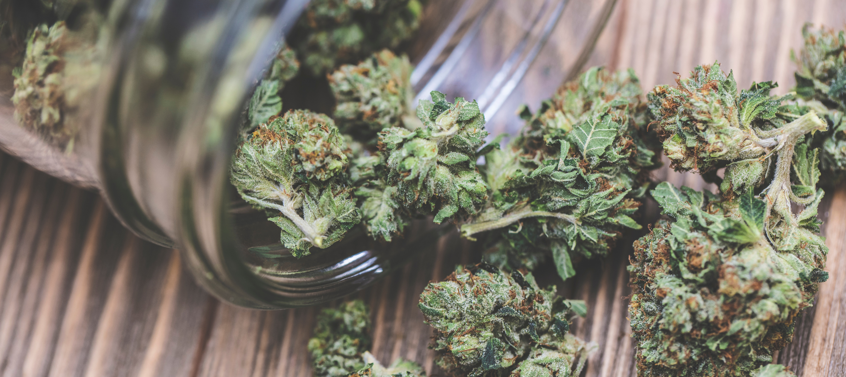
The U.S. Food and Drug Administration (FDA)
has NOT found that marijuana is safe or effective for treating any health problems.
(NIH)
States have legalized medical marijuana because of decisions made by voters or legislators –
not because of scientific evidence of its benefits and risks.
FOCUS ON PREVENTION
Notes:
Source: FDA Regulation of Cannabis and Cannabis-Derived Products, Including Cannabidiol (CBD) | FDA

Slide 12
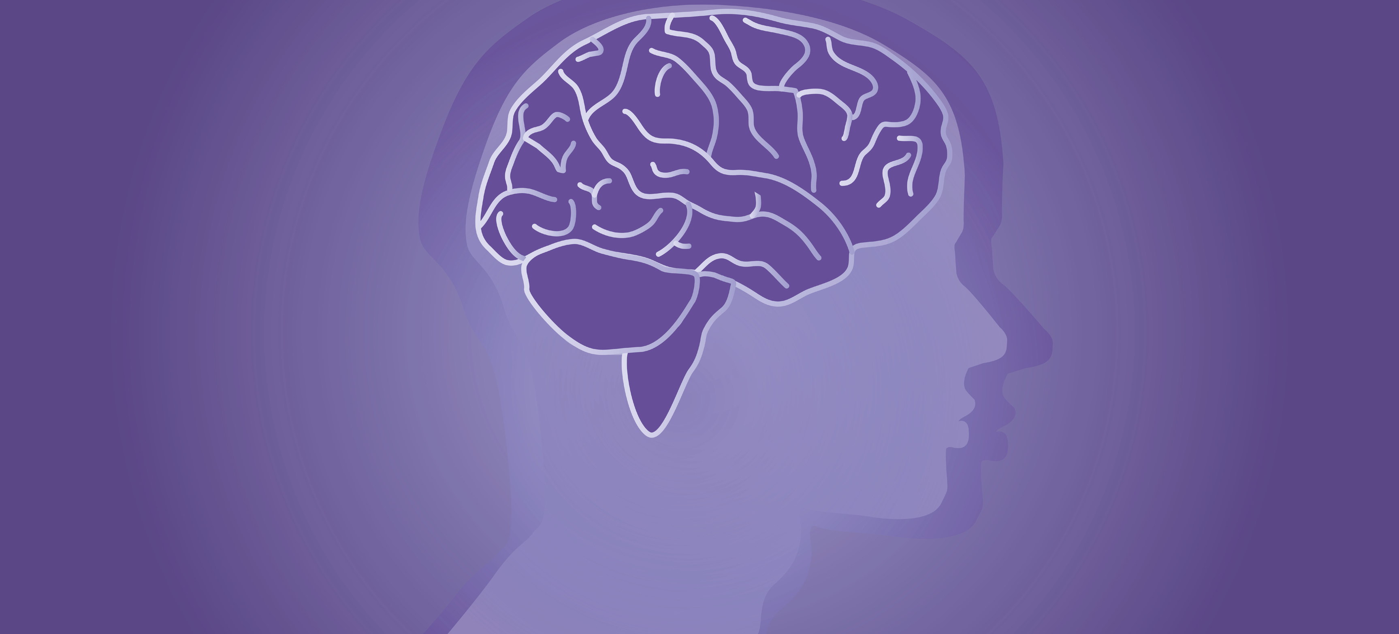
BECAUSE OF CONCERNS OVER THE POSSIBLE HARM TO THE DEVELOPING TEEN BRAIN,
NON-MEDICAL MARIJUANA USE BY PEOPLE UNDER AGE 21
IS PROHIBITED IN ALL STATES.
(NIDA)
FOCUS ON PREVENTION
Notes:
Source: Cannabis (Marijuana) | National Institute on Drug Abuse (NIDA) (nih.gov)

Slide 13
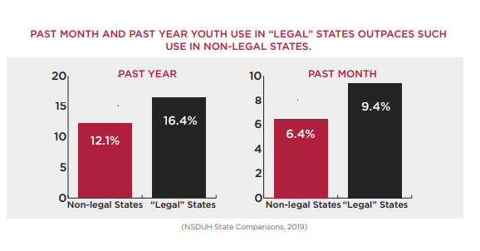
YOUTH MARIJUANA USE CONTINUES TO RISE IN STATES THAT HAVE LEGALIZED.
FOCUS ON PREVENTION
Notes:
Source: SAM Releases Fourth Annual Report on Harms of Marijuana Legalization – Smart Approaches to Marijuana (learnaboutsam.org)

Slide 14
Teens who use marijuana are more than three times as likely to attempt suicide between the ages of 18 and 32.
(Partnership to End Addiction)
FOCUS ON PREVENTION
Notes:
Source: Teen Marijuana Use Linked to Increased Depression and Suicidal Behavior: Study - Partnership to End Addiction (drugfree.org)

Slide 15
Individuals in late adolescence and early adulthood, especially males, are at the highest risk for developing marijuana use disorder.
(Partnership to End Addiction)
FOCUS ON PREVENTION
Notes:
Source: Marijuana: What You Need to Know to Help Protect Children, Teens and Young Adults - Partnership to End Addiction (drugfree.org)

Slide 16
More young people are in treatment for marijuana abuse or dependence than for the use of alcohol and all other drugs.
FOCUS ON PREVENTION
Notes:
Source: New Study: Marijuana Legalization and Normalization is Reversing Decades of Declines in Youth Marijuana Use – Smart Approaches to Marijuana (learnaboutsam.org)

Slide 17
"I am emphasizing the importance of protecting our Nation from the health risks of marijuana use in adolescence and during pregnancy. Recent increases
in access to marijuana and in its potency, along with misperceptions of safety of marijuana endanger our most precious resource, our nation’s youth."
~Surgeon General VADM Jerome Adams
TALK TO THEM…THEY ARE LISTENING.
FOCUS ON PREVENTION
Notes:
Source: Surgeon General’s Advisory: Marijuana Use & the Developing Brain | HHS.gov

Slide 18
TALKING TO OUR CHILDREN ABOUT MARIJUANA USE ISN’T ALWAYS EASY…
BUT IT IS CRUCIAL FOR PREVENTION.
SILENCE ISN'T GOLDEN – IT'S PERMISSION.
FOCUS ON PREVENTION
Notes:
Source: Marijuana: Facts Parents Need to Know: A Letter to Parents | NIDA (nih.gov)

